Slide 1

Objectives
In this session, you will learn to:
  Define Internet, WWW, and HTML
  Create a Web page
  Create hyperlinks
  Identify the requirements for publishing a website
  Add colors and backgrounds to a Web page
  Add images to a Web page

Slide 2
Introduction to the Internet, World Wide Web, and Hypertext Markup Language
The Internet is a vast interconnection of computers that connects computers across the world.
World Wide Web (WWW):
  The WWW, popularly known as the Web, is a collection of several electronic documents called Web pages.
  These Web pages are interlinked by using hypertext.
  Hypertext, also known as hyperlink, connects the content on one Web page to the content on another Web page.
  A set of interconnected Web pages displaying related information on a particular subject is called a website.
  Each website has a unique address on the Internet, known as the Uniform Resource Locator (URL).
  To view a website, a program called Web browser is used.
  Web browser opens the home page of a website, after a user specifies the URL of the website in the browser window.

Slide 3
Introduction to the Internet, World Wide Web, and Hypertext Markup Language (Contd.)
Hypertext Markup Language (HTML):
  Is a collection of platform-independent styles used to create a Web document or a Web page.
  Indicates the way in which the document is to be read by the browser.
  Provides tags that you can use to insert graphics, and specify the fonts and colors for the various elements on a Web page.

Slide 4
Considerations Involved in Web Page Creation
The success of a website largely depends on how effectively it addresses user requirements.
The considerations involved in creating an accessible website are:
  Front-end considerations:
    Are concerned with the visual interface of a Web page.
    Includes interface design and design standards.
  Back-end considerations:
    Are concerned with the faster download of Web pages and easy accessibility of back-end databases.
    Includes bandwidth and download time.

Slide 5
Editors Used for Creating Web Pages
Editors that can be used for creating Web pages are of two types:
  Text editors:
    Text editors allow you to type and save HTML code in the form of text files.
    The text files created are saved with the .htm or .html extension.
  GUI editors:
    Are known as What You See Is What You Get (WYSIWYG) editors.
    Are user-friendly and do not require the user to have any programming knowledge for creating Web pages.
    Provide various tools and components that helps a user to create HTML documents easily and quickly.

Slide 6
Structure of an HTML Document
An HTML document can be created by combining various tags.
Tags are special markup codes enclosed in angle brackets that define the structure of the HTML document.
An HTML document contains the following structural tags:
  <!DOCTYPE>
  <HTML>
  <HEAD>
  <BODY>
  <SCRIPT>

Slide 7
Formatting an HTML Document
Web pages can be formatted using various formatting tags.
The two categories of formatting tags are:
  Block level tags
  Text level tags
Apart from block level tags and text level tags, there are list tags used to represent a group of elements.

Slide 8
Formatting an HTML Document (Contd.)
Block Level Tags:
  Paragraph tag: <P>
  Line Break tag: <BR>
  Horizontal Rule tag: <HR>
  Heading tags: <H1> to <H6>
  Formatting tag: <PRE>
  Blockquote tag: <BLOCKQUOTE>
  Center tag: <CENTER>

Slide 9
Formatting an HTML Document (Contd.)
Text Level Tags:
  <FONT> tag
  <B> tag
  <I> tag
  <U> tag
  <SUB> and <SUP> tags
  <STRIKE> tag

Slide 10
Formatting an HTML Document (Contd.)
List Tags:
  Are compound, block level tags, commonly used in HTML documents.
  Have some attributes that enable you to manipulate the appearance of the lists and in turn the appearance of the Web page.
  Can be nested.
The various types of lists used in HTML are:
  Ordered or numbered lists
  Un-ordered or bulleted lists
  Definition lists

Slide 11
Demo: Creating a Web Page
Problem Statement:
  Oats and Meals is a leading restaurant chain in North America. As a part of the company’s marketing strategy, the senior management has decided to hire a software organization, WeBuildWebs Inc., to develop their website. You are a Web developer at WeBuildWebs Inc., and have been assigned the task of creating a sample Home page for Oats and Meals.

Slide 12
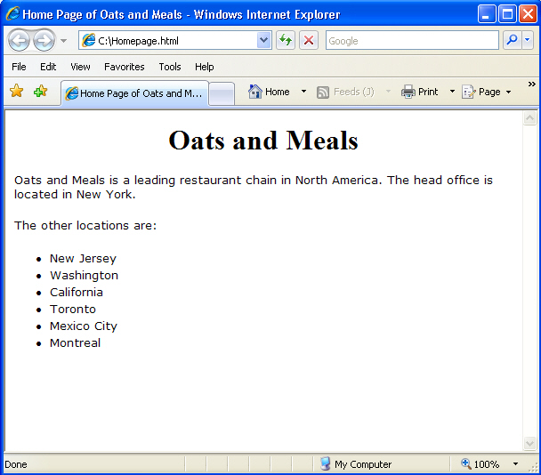
Demo: Creating a Web Page (Contd.)
  The following figure displays a sample home page for the Oats and Meals website.

Slide 13
Demo: Creating a Web Page (Contd.)
Solution:
  To solve the preceding problem, you need to perform the following tasks:
    Create the Oats and Meals home page.
    View the Web page and verify the output.

Slide 14
Linking Web Pages
Hyperlinks are used to provide links to Web pages, images, multimedia files, and documents of applications.
Hyperlinks in HTML are created using the anchor tag.
An anchor tag is represented by <A>…</A> tags.
The attributes of an anchor tag are:
  HREF
  TITLE
  TARGET
  NAME

Slide 15
Demo: Creating Hyperlinks
Problem Statement:
  You have created the home page and several other Web pages for the Oats and Meals website. You need to link all the Web pages to the home page. For this, you are required to create appropriate hyperlinks in the home page. The following Web pages have already been created for the Oats and Meals website:
    Aboutus.html
    BranchesandLocation.html
    Recipe.html
    SubmitARecipe.html
    PlaceYourOrder.html

Slide 16
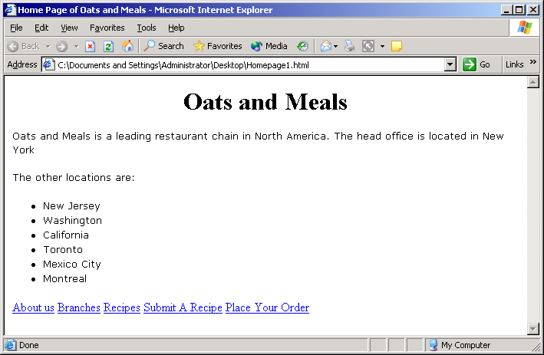
Demo: Creating Hyperlinks (Contd.)
  The following figure displays the sample home page after the hyperlinks have been added.

Slide 17
Demo: Creating Hyperlinks (Contd.)
Solution:
  To solve the preceding problem, you need to perform the following tasks:
    Create the hyperlinks.
    View the Web page and verify the output.

Slide 18
Website Hosting
Hosting provides storage space for uploading Web documents.
To make a website available over the Internet, host the site documents on the server space provided by an ISP.
The requirements to host a website are:
  The URL of a Web server on which the site is to be hosted.
  A user name and password to access and publish content of the Web page on the Web server.

Slide 19
Naming Conventions for Web Pages
Naming conventions are a set of rules followed for naming Web pages.
Hosting service providers have their own set of conventions supported by their Web server to ensure that the website functions properly.
Some of the common default file names for home pages are:
  index.html/ index.htm
  default.html/ default.htm
  welcome.html/ welcome.htm
  home.html/ home.htm

Slide 20
Page Colors and Backgrounds
The appearance of Web pages can be changed by adding colors to the background, text, fonts, tables, and links in the HTML file.
HTML provides various tags and their associated attributes to set colors on a Web page.

Slide 21
Page Colors and Backgrounds (Contd.)
The following table lists the various tags and attributes to set colors on a Web page.
Tags and their Associated Attributes | Role
<BODY BGCOLOR=“color name”> …Content… </BODY> | Background Color
<BODY TEXT=“color value”> …Content… </BODY> | Text Color
<BODY LINK= “color value” VLINK= “color value” ALINK= “color value”> …Content… </BODY> | Link Color
<FONT COLOR= “font color”> text</FONT> | Font Color

Slide 22
Specifying Colors in HTML
HTML colors are defined by the combination of three basic colors: Red, Green, and Blue.
In an HTML file, a color can be represented either by using its name or by using a corresponding hexadecimal code.

Slide 23
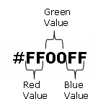
Hexadecimal Color Codes
Colors such as red, green, and blue have different intensities, which is known as the RGB values.
The RGB values range between 0 and 255 for a color. These values are represented using hexadecimal codes in HTML.
The following figure shows the format of the hexadecimal color code for the color, Fuchsia.

Slide 24
Hexadecimal Color Codes (Contd.)
  The following table lists some colors with their hexadecimal codes and corresponding RGB values.
Color Name | Hexadecimal Code | RGB Value
Black | #000000 | 0,0,0
White | #FFFFFF | 255,255,255
Red | #FF0000 | 255,0,0
Green | #00FF00 | 0,255,0
Blue | #0000FF | 0,0,255

Slide 25
Web Safe Color Palette
Web-safe colors are the range of colors that are supported by a majority of computer platforms.
Web-safe colors can be identified from their RGB values and hexadecimal codes.
A color whose RGB value is either 0 or a multiple of 51 for each of its components, such as Red, Green ,and Blue, is identified as a Web-safe color.
Colors, whose hexadecimal codes for red, green, and blue are 00, 33, 66, 99, CC, or FF are considered Web-safe.

Slide 26
Demo: Adding Colors to a Web Page
Problem Statement:
  You have developed a website for BeautyInFitness, an organization that deals in quality health products. You need to enhance the interface of the website using colors that are supported across browsers. The color of the background, text, and hyperlinks of all the Web pages need to be modified.

Slide 27
Demo: Adding Colors to a Web Page (Contd.)
Solution:
  To solve the preceding problem, you need to perform the following tasks:
    Open the index.htm Web page.
    Modify the colors of the index.htm Web page.
    Open the product_1.htm Web page.
    Modify the colors of the product_1.htm Web page.
    Open the product_2.htm Web page.
    Modify the colors of the product_2.htm Web page.
    Open the product_3.htm Web page.
    Modify the colors of the product_3.htm Web page.
    Open the product_4.htm Web page.
    Modify the colors of the product_4.htm Web page.
    View the Web pages and verify the output.

Slide 28
Using Images on a Web Page
Images help to enhance the visual appeal of a Web page.
They enable users to recollect facts faster.
The three formats of images popular on the Web are:
  Graphic Interchange Format (GIF )
  Joint Photographic Experts Group (JPEG )
  Portable Network Graphics (PNG )
HTML uses the <IMG> tag to place static as well as animated images in a Web page.
The following two image formats can be inserted using the <IMG> tag:
  GIF
  JPEG

Slide 29
Using Images on a Web Page (Contd.)
The attributes of the <IMG> tag are:
  ALIGN
  BORDER
  WIDTH
  HEIGHT
  HSPACE
  VSPACE
  ALT
  SRC

Slide 30
Using Images on a Web Page (Contd.)
Image Maps:
  Image map is a technique of dividing an image into sections that link to different pages.
  The sections that link to different pages are known as hotspots.
  Different kinds of hotspots can be created on a large image, such as:
    Circular hotspot
    Polygonal hotspot
    Rectangular hotspot

Slide 31
Using Images on a Web Page (Contd.)
  To create an image map in HTML, the <MAP> tag is used.
  The NAME attribute of the <MAP> tag specifies the name of the map referred to in the HTML document.
  The <MAP> tag is used with an <AREA> tag that is specified inside the <MAP> tag.
  The <AREA> tag is used to specify the properties for specific areas of an image.
  The attributes of the <AREA> tag are as follows:
    SHAPE
    COORDS
    HREF

Slide 32
Demo: Adding Images to a Web Page
Problem Statement:
  You are creating the Product Gallery Web page for the BeautyInFitness website. The Web page should display images of the products and services provided by BeautyInFitness. The information about a product or service should be provided as soon as the user clicks on any image. How will you achieve the desired task?

Slide 33
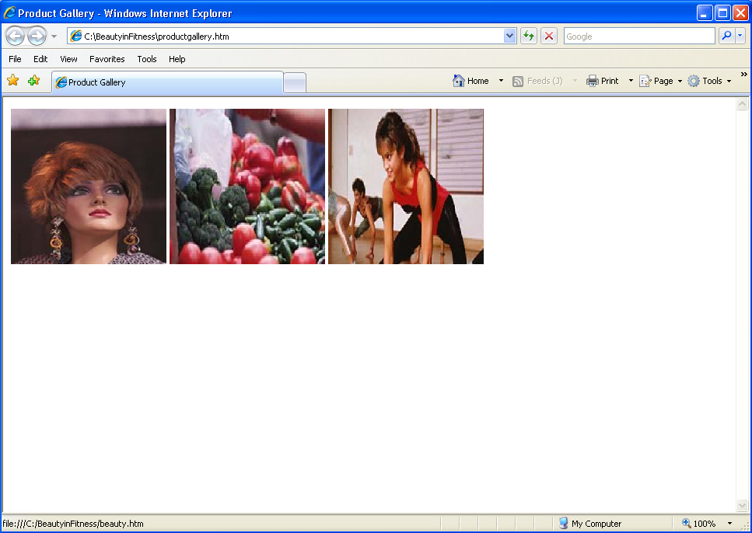
Demo: Adding Images to a Web Page (Contd.)
  The following figure is a sample Product Gallery Web page for the BeautyInFitness website.

Slide 34
Demo: Adding Images to a Web Page (Contd.)
Solution:
  To solve the preceding problem, you need to perform the following tasks:
    Open the productgallery.htm Web page.
    Specify the hyperlinks on the images.
    View the Web pages and verify the output.

Slide 35
Summary
In this session, you learned that:
  The Internet is a vast interconnection of computers that connects computers across the world.
  The WWW, popularly known as the Web, is a collection of several electronic documents called Web pages, which are interlinked with each other.
  Interconnection among Web pages is achieved by using hypertexts, also know as hyperlinks.
  A Web browser lets you specify the URL of a website and opens the home page of the website.
  HTML is a collection of platform-independent styles used to create a Web document or a Web page.
  Before creating Web pages for a website, you need to consider several factors such as, usability and efficiency of the website.

Slide 36
Summary (Contd.)
  Editors that can be used for creating Web pages are of two types:
    Text editors
    Graphic User Interface (GUI) editors
  Graphic User Interface (GUI) editors are also called as What You See Is What You Get (WYSIWYG) editors. GUI editors provide various tools and components with point and click functionality.
  Publishing a website involves copying the website content to a Web server and making the site available over the Internet.
  Hosting is a service that provides storage space for uploading Web pages.

Slide 37
Summary (Contd.)
  You can change the appearance of Web pages by adding colors to the background, text, fonts, tables, and links in the HTML document.
  The BGCOLOR attribute of the <BODY> tag is used to set the color for the background of the Web page.
  The TEXT attribute of the <BODY> tag is used to set the color for the text in the Web page.
  Colors can be set for various states of a hyperlink, such as unvisited hyperlink (LINK), active hyperlink (ALINK), and visited hyperlink (VLINK) on the Web page.
  The COLOR attribute of the <FONT> tag is used to set the colors for a selected text in the Web page.
  Colors such as red, green, and blue have different intensities, known as the RGB values. The RGB values for a color ranges between 0 and 255. These values are represented using hexadecimal codes in HTML.

Slide 38
Summary (Contd.)
  Web-safe colors are a range of colors supported by a majority of computer platforms.
  Three formats of images are popular on the Web:
    GIF
    JPEG
    PNG
  HTML uses the <IMG> tag to place static as well as animated images on a Web page.
  Image mapping is the process of dividing an image into several regions that may be linked to different Web pages on a website.
  A hotspot is a region on an image that acts as a hyperlink.

Slide 39
Summary (Contd.)
  The following types of hotspots can be created using the <IMG> tag:
    Circular hotspot
    Polygonal hotspot
    Rectangular hotspot
  The <MAP> tag is used to create an image map in HTML.
  The <MAP> tag is used with an <AREA> tag that is specified inside the <MAP> tag.

